Slide 1
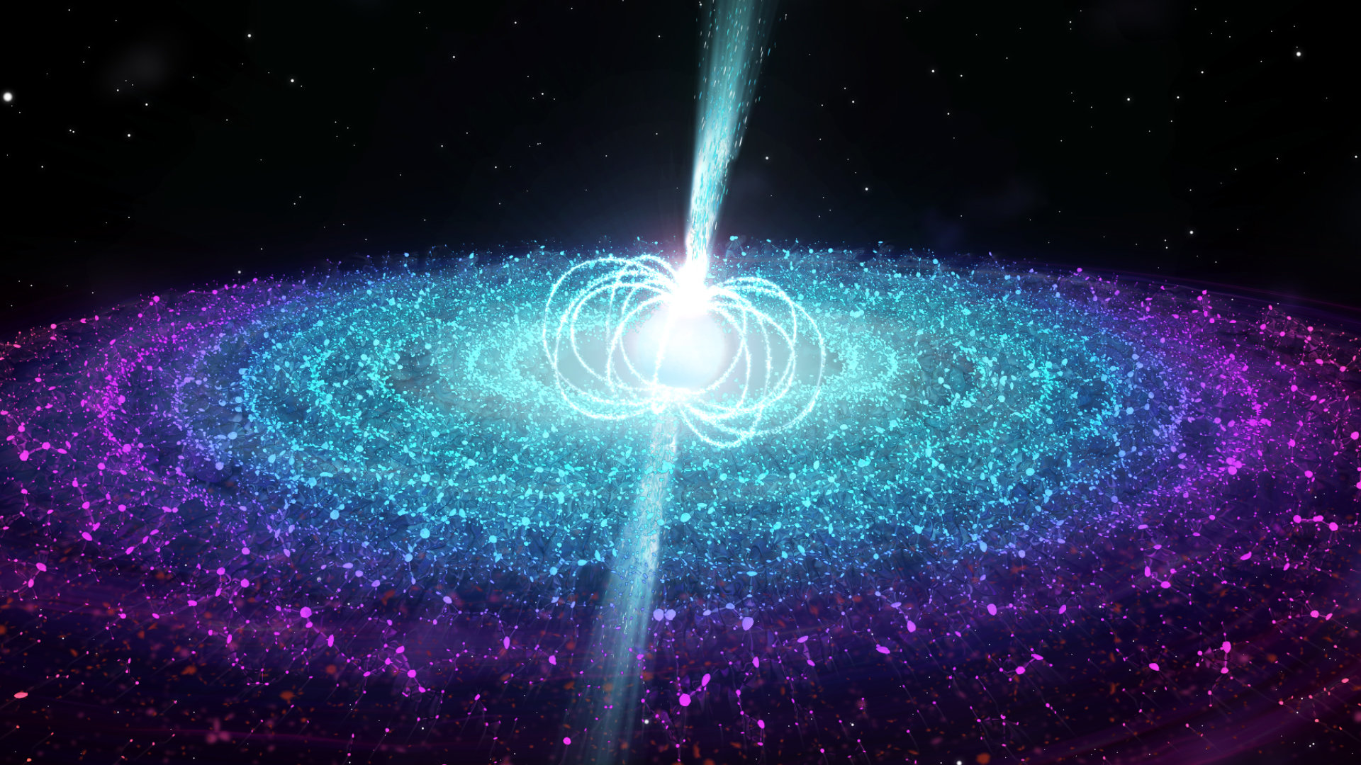
Pulsar Star Classification
Section B, Team #30
Avani Bhargava, Chu-Ru (Ruth) Cheng, Roshni Shahani, Xinyan (Sarah) Wang,
Yuchen (Vinnie) Zhang

Slide 2
Introduction
Source:
“Predicting a Pulsar Star”, Kaggle Dataset,
School of Physics and Astronomy at University of Manchester
(17,898 records and 8 variables)
Business Understanding:
Cost-saving method to weed out noises
E(value - cost | target)

Slide 3
Data Understanding
Out of the 17,898 observations only 1,639 are real pulsar emissions
Each described by 8 continuous variables and a single class variable
The first four variables are simple statistics obtained from integrated pulse profile:
Mean, Standard deviation,Excess Kurtosis, Skewness
The remaining four variables are from dispersion measure signal to noise ratio (DM-SNR) curve:
Mean, Standard deviation,Excess Kurtosis, Skewness

Slide 4
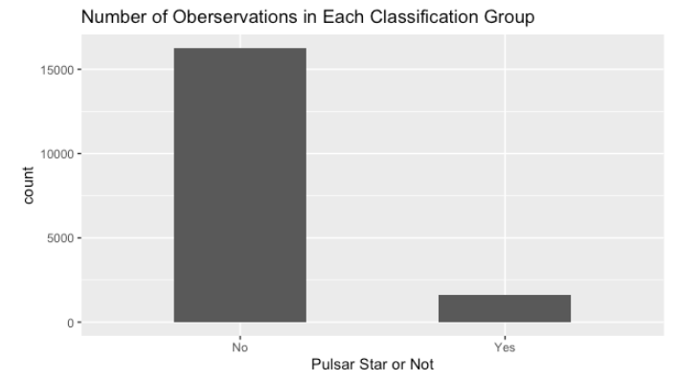
Data Preparation and Cleaning
The data had no missing values
Converted the target_class variable from 0,1 to Yes\No
Only ~9% detected as pulsar star emissions
To handle this imbalance in data, used the SMOTE() function

Slide 5
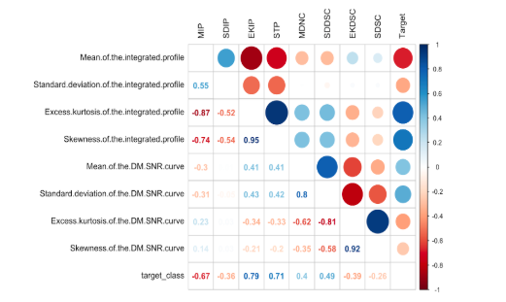
Data Exploration
For exploratory analysis we plotted histograms for all variables
We checked for multicollinearity using the correlation plot
Kurtosis has high correlation with skewness

Slide 6
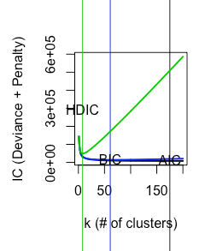
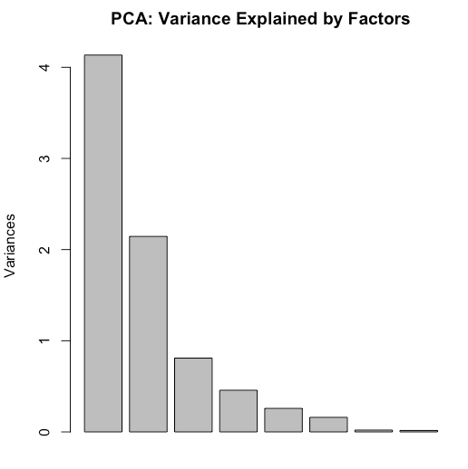
Unsupervised Learning
k-means clustering
Using IC built an 8-means clustering model with two clusters containing majority real pulsars
Principal Component Analysis
Plotted the variance against factors and got three explanatory factors

Slide 7
Modeling
Nine Classification Models
Logistic regression
Logistic regression without highly correlated variables
Logistic regression with stepwise selection using AIC
Logistic regression with interaction using Lasso
Decision tree
K-NN
Support Vector Machine (SVM)
Random forest
Neural network
10-fold cross validation for OOS performance
Area under ROC curve
Sensitivity, specificity, accuracy, kappa

Slide 8
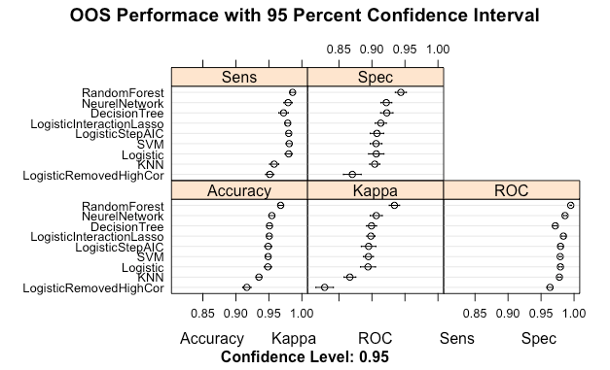
Notes:
The kappa statistic is used to control only those instances that may have been correctly classified by chance. This can be calculated using both the observed (total) accuracy and the random accuracy. Kappa can be calculated as:
Kappa = (total accuracy – random accuracy) / (1- random accuracy).

Slide 9
Evaluation
OOS Performance
Random Forest (OOS AUC = 0.995)
Neural Network (OOS AUC = 0.986)
Logistic Interaction Lasso (OOS AUC = 0.984)
Apply to test sample
Change thresholds - 50% best accuracy
ROC curve
Cumulative Response Curve
Random Forest
Best OOS Performance
Best in addressing multicollinearity
Not as computationally expensive

Slide 10
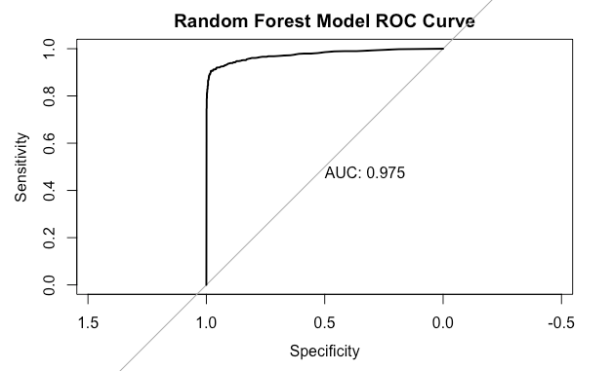
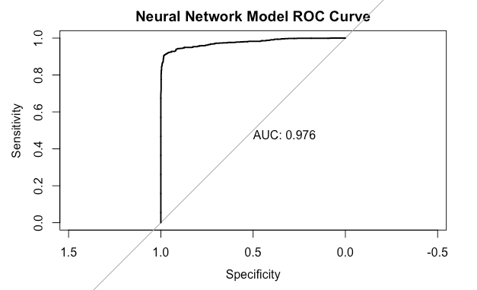
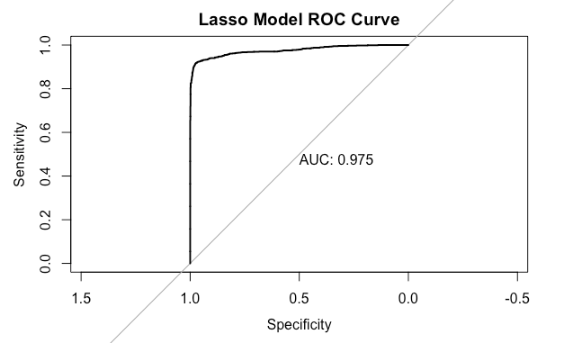
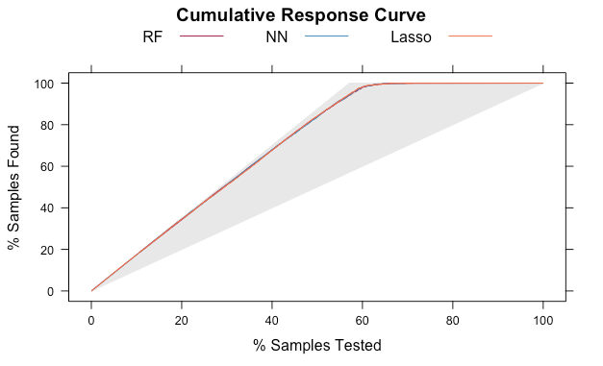

Slide 11
Deployment
Type I vs. Type II
false positive cost E(cost | target)
false negative lost E(value | not target)
Need more domain knowledge in analyzing cost-benefit
E(value - cost| target)
For future scientific research
The Universe is sparse
Data is imbalanced
More sophisticated model for even better accuracy

